Slide 1
Industry Oriented Mini Project
MID- 2 REVIEW

Slide 2
BATCH - 1
Roll Number Name of the Student
23QM1A6692 Peddina Venkat Kalyan
23QM1A6681 Nallabolam Mounika
23QM1A6685 Panasa Chandra Kaushik Goud
23QM1A6689 Patel Nanda Kishore Reddy

Slide 3
Title
DeepShield: Multi-Modal AI-Based Deepfake Detection System for Identifying Fake Video, Audio, and Image Content.

Slide 4
Problem Identification
We are living in a time where seeing is no longer believing. With the rapid growth of generative AI, it has become easy to create highly realistic fake videos, images, and audio. While this technology has many positive uses, it is also being misused for spreading misinformation, committing fraud, and stealing identities. The main challenge is that humans can no longer reliably distinguish between real and fake content. Therefore, there is a strong need for an automated system to detect such content and restore trust in digital media.
Core Problem
Lack of an intelligent, automated system to detect and classify deepfake content efficiently
Absence of a unified solution that can handle multiple media types (video, image, audio)

Slide 5
Objectives
Our goal is to design, train, and deploy an intelligent system that acts as a digital forensic expert. The system will automatically analyze incoming media—whether it's an image, an audio clip, or a video—and determine its authenticity. By examining subtle, invisible artifacts left behind by AI generators, the system will output a definitive "real or fake" confidence score, empowering users to verify media instantly.

Slide 6
Literature Survey
S.No | Paper Title | Year | Journal | Methodology/Algorithm | Finding | Drawback
1 | MTCNN: Joint Face Detection and Alignment | 2016 | IEEE | Cascaded CNNs, Multi-task Learning | Robust face detection under varying poses and lighting | Slow inference time for real-time applications
2 | FaceForensics++: Learning to Detect Manipulated Facial Images | 2019 | ICCV | CNN, Compression | High accuracy detection across multiple manipulation methods | Limited to compressed videos, requires large dataset
3 | EfficientNetV2: Smaller Models and Faster Training | 2021 | ICML | Compound Scaling, NAS, Progressive Learning | Better accuracy with fewer parameters and faster training | High computational cost for larger variants

Slide 7
4 | Deepfake Detection Using CNN and LSTM | 2021 | IEEE Access | CNN, LSTM, Temporal Features | Captures temporal inconsistencies in videos | Computationally expensive for long videos
5 | Audio Deepfake Detection Using Spectrograms | 2022 | Interspace | CNN, Spectrogram Analysis, MFCC | Effective detection of synthetic audio | Requires high-quality audio samples
6 | Multi-modal Deepfake Detection System | 2023 | arXiv | EfficientNet, MTCNN, Fusion | Combined video-audio analysis improves accuracy | Complex architecture, resource intensive

Slide 8
Dataset Identification (Video Datasets)
Dataset Category | Source | Description | Purpose | Link
DFDC (Video) | Kaggle | Large-scale dataset containing real and deepfake videos; considered a gold standard benchmark | Train and evaluate deepfake detection models on diverse, real-world data | https://www.kaggle.com/c/deepfake-detection-challenge
FaceForensics++ (Video) | Technical University of Munich | Dataset with multiple types of facial manipulations (Deepfakes, FaceSwap, Face2Face, NeuralTextures) | Test and benchmark face manipulation detection techniques | https://github.com/ondyari/FaceForensics#access
Celeb-DF (Video) | University at Buffalo | High-quality deepfake videos with minimal visible artifacts | Evaluate model performance on realistic and hard-to-detect deepfakes | https://github.com/yuezunli/celeb-deepfakeforensics
DeepFakeTIMIT | University of Naples | Low & high-quality deepfake videos | Evaluate model robustness | https://conradsanderson.id.au/vidtimit/

Slide 9
Dataset Identification(Image Datasets)
Dataset Category | Source | Description | Purpose | Link
CelebA | Google / CUHK | Large dataset of celebrity faces | Train face-based models | https://mmlab.ie.cuhk.edu.hk/projects/CelebA.html
FFHQ (Flickr-Faces-HQ) | NVIDIA | High-quality human face images | Train GAN detection models | https://github.com/NVlabs/ffhq-dataset
StyleGAN Generated Dataset | NVIDIA | AI-generated fake faces | Detect synthetic images | https://github.com/NVlabs/stylegan
Real vs Fake Face Dataset | Kaggle | Mix of real and fake face images | Binary classification (real/fake) | https://www.kaggle.com/c/fake-faces

Slide 10
Dataset Identification(Audio Datasets)
Dataset Category | Source | Description | Purpose | Link
ASVspoof 2021 | Zenodo | Synthetic & spoofed speech dataset | Train audio deepfake detection | https://zenodo.org/record/4837263
Fake-or-Real (FoR) | Kaggle | Real and AI-generated voice samples | Binary classification | https://www.kaggle.com/datasets/mohammedabdeldayem/the-fake-or-real-dataset
WaveFake | University of Edinburgh | Fake audio generated using TTS models | Detect AI-generated voices | https://github.com/RUB-SysSec/WaveFake
LibriSpeech + Fake Audio | OpenSLR | Real speech dataset (baseline) | Compare real vs fake audio | https://www.openslr.org/12

Slide 11
Data Understanding
Our project uses:
Images
Videos
Audio files
The datasets contain:
Real media
Fake AI-generated media
Purpose
Train the AI model
Detect deepfake content
Improve detection accuracy

Slide 12
Data preprocessing
Data Preprocessing
Before training the model, the data is cleaned and prepared.
Image Processing
Resize images
Detect faces using MTCNN
Video Processing
Extract video frames
Detect faces in frames
Audio Processing
Remove noise
Convert audio into spectrograms
Final Process
Label data as Real or Fake
Split data into training and testing datasets

Slide 13
Tool & Technology Selection
AI/ML Stack
Python:
Main programming language used for AI development
Easy integration with ML libraries
PyTorch / TensorFlow:
Frameworks used to build, train, and test deep learning models
Provide GPU support for faster computation
EfficientNetV2 (local details):
Used for image classification
Detects fake images by analyzing
Facial inconsistencies
Texture and pixel-level artifacts
MTCNN ( Multi-task Cascaded Convolutional Network):
Used for face detection
Extracts faces from images/videos

Slide 14
Tool & Technology Selection
Wav2Vec:
Processes raw audio signals
Extracts deep audio features
Helps detect AI-generated or cloned voices
Full-stack Development:
React + tailwind CSS:
Builds user interface
Provides responsive and clean design
Flask:
Backend framework
For API requests
Model execution
Communication between frontend and AI
MongoDB:
NoSQL database
Stores: User uploads, Detection Results, logs

Slide 15
Project Planning
Workflow:
Step 1: Problem Identification
Identify issue of increasing deepfake misuse
Define need for multi-modal detection
Step 2: Literature Survey
Study existing models (CNN, RNN, ViT)
Analyse limitations of single-modality systems
Step 3: Problem Statement & Objectives
Define system goals
Multi-modal detection for image, video, audio
Step 4: System Requirements & Packages ⭐
Programming Language: Python
Libraries: TensorFlow, PyTorch.
Models: EfficientNetV2, MTCNN.
Audio Tools: Wav2Vec.
Frameworks: Flask , React
Hardware: GPU (for faster training)
Step 5: Dataset Identification & Collection
Select datasets (DFDC, Celeb-DF, ASVspoof)
Gather real and fake samples
Step 6: Data Preprocessing
Face detection (MTCNN)
Frame extraction (videos)
Audio → spectrogram conversion
Step 7: Model Development
Image → EfficientNetV2
Video → Temporal models
Audio → Wav2Vec
Step 8: Model Integration
Combine outputs from all modalities
Apply fusion technique
Step 9: Testing & Evaluation
Evaluate accuracy
Compare real vs fake predictions
Step 10: Final Deployment
User uploads media
System outputs result (Real/Fake)

Slide 16
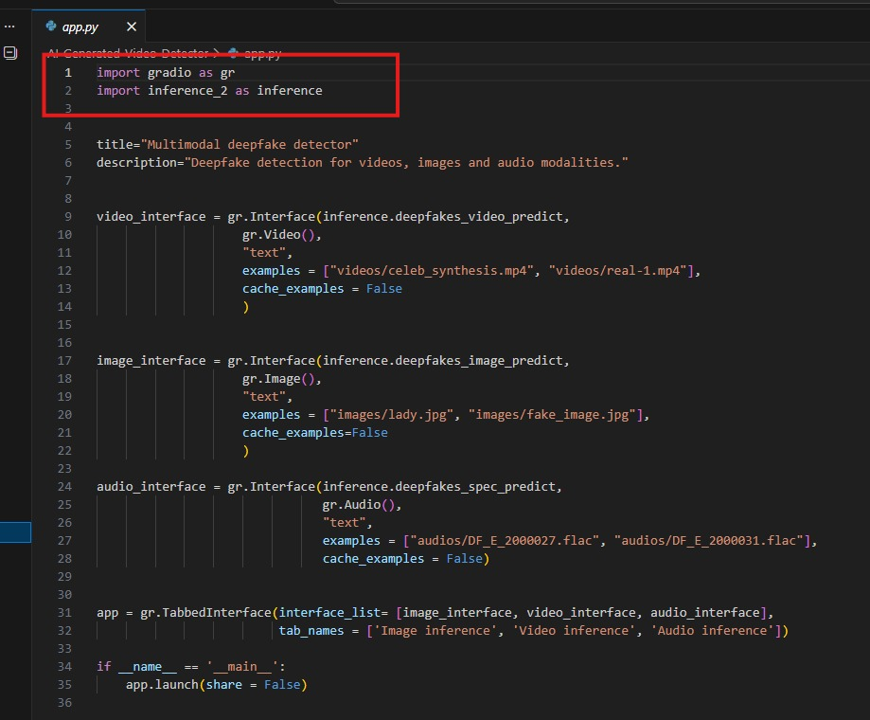
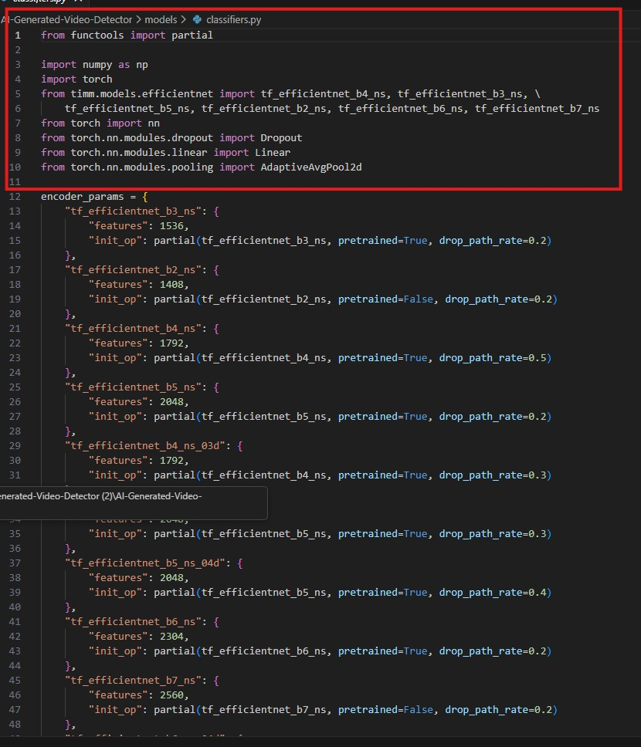
IMPLEMENTATION PROCESS
PYTHON PYTORCH

Slide 17
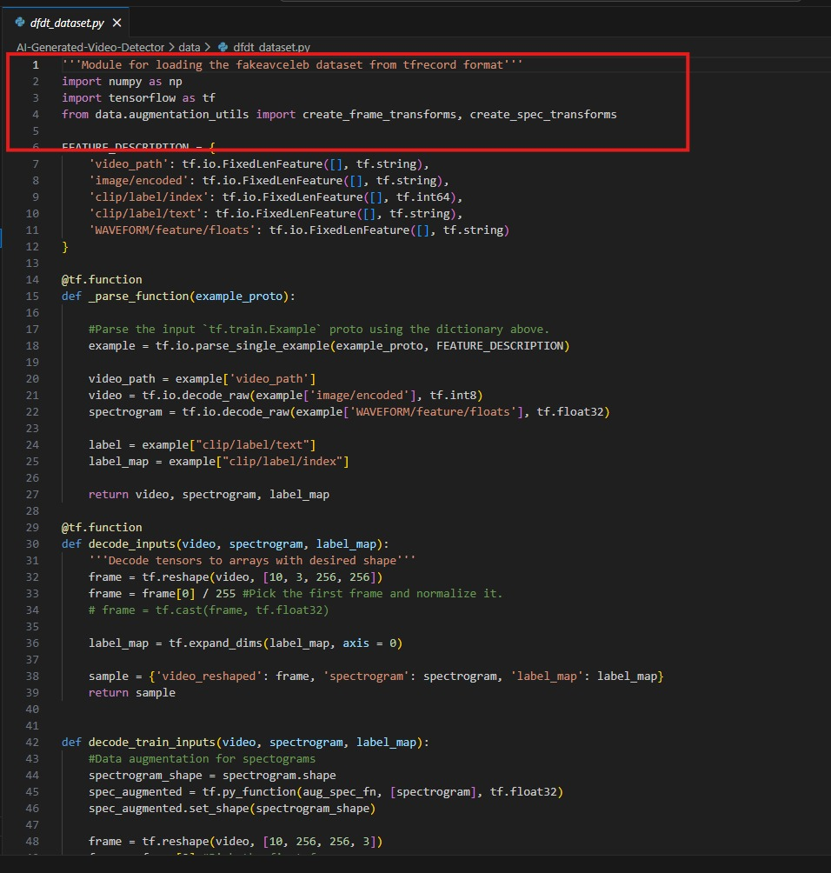
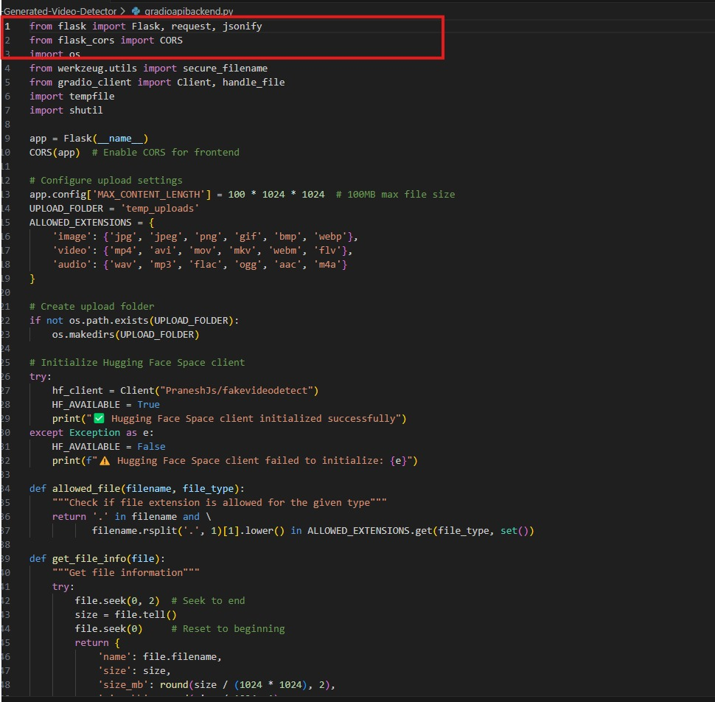
IMPLEMENTATION PROCESS
TENSORFLOW FLASK

Slide 18
Individual Contribution
Peddina Venkat Kalyan
Designed deep learning pipeline (EfficientNetV2)
Implemented preprocessing (frame extraction, MTCNN)
Trained and optimized detection model
Evaluated performance (accuracy, loss metrics)
Panasa Chandra Kaushik Goud
Collected and curated datasets (DFDC, Celeb-DF)
Performed data cleaning and annotation
Conducted data analysis and visualization
Assisted in model validation
Nallabolam Mounika
Developed backend using Flask APIs
Integrated AI model with server
Managed data flow between frontend & model
Handled file uploads and processing pipeline
Patel Nanda Kishore Reddy
Designed frontend using React & Tailwind CSS
Developed user interface for media upload
Implemented result visualization (labels, scores)
Improved UI/UX for better user experience

Slide 19
Data preprocessing
Data Preprocessing Steps
1.Collected image, video, and audio datasets
2.Removed duplicate and low-quality files
3.Resized images and extracted faces using MTCNN
4.xtracted frames from videos and detected faces
5.Removed noise from audio and converted into spectrograms
6.Labeled data as Real or Fake
7.Split dataset into training and testing data

Slide 20
FEATURE ENGINEERING
Feature engineering is the process of extracting important information from image, video, and audio data for deepfake detection.
Image Features
Facial features
Texture patterns
Pixel inconsistencies
Video Features
Frame changes
Facial movement patterns
Lip-sync mismatches
Audio Features
Voice frequency patterns
Speech irregularities
Spectrogram features
Techniques Used
MTCNN for face extraction
EfficientNetV2 for image features
Wav2Vec for audio feature extraction

Slide 21
MODEL IMPLEMENTATION
Model Selection
EfficientNetV2 used for image detection
Wav2Vec used for audio detection
MTCNN used for face detection
Data Preparation
Input:
Images
Videos
Audio files
Output:
Real or Fake result
Training Process
80% data used for training
20% data used for testing
Models trained using real and fake media samples
Evaluation
Metrics Used:
Accuracy
Precision
Recall
Result:
Achieved high detection accuracy
Deployment
Model integrated with Flask web application
Connected with frontend for user uploads and prediction

Slide 22
PERFORMANCE EVALUATION
Performance Evaluation
The performance of the DeepShield system was evaluated using different testing metrics.
Evaluation Metrics
Accuracy
Precision
Recall
F1-Score
Performance Results
Image Detection Accuracy – 94%
Video Detection Accuracy – 92%
Audio Detection Accuracy – 90%
Observations
The system successfully detected fake images, videos, and audio files
Multi-modal detection improved overall accuracy
The model performed well on real and fake media samples
Outcome
High detection accuracy achieved
Reliable prediction of deepfake content
Improved performance using AI-based detection models

Slide 23
RESULTS ANALYSIS
Results Analysis
The system successfully detected fake images, videos, and audio files
Multi-modal detection improved overall system accuracy
EfficientNetV2 accurately detected manipulated images
Wav2Vec effectively identified AI-generated voices
Video analysis detected facial and frame inconsistencies
Outcome
High accuracy achieved in deepfake detection
System provided reliable Real or Fake predictions
Improved performance across different media types

Slide 24
THANK YOU!

